Slide 1
Natural Frequencies and Mode shapes of a square plate
MAE 529
Ezra D Rowitsch
12/16/2020

Slide 2
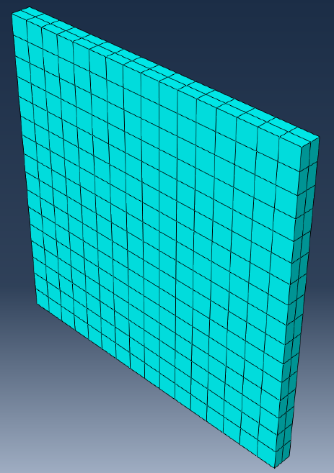
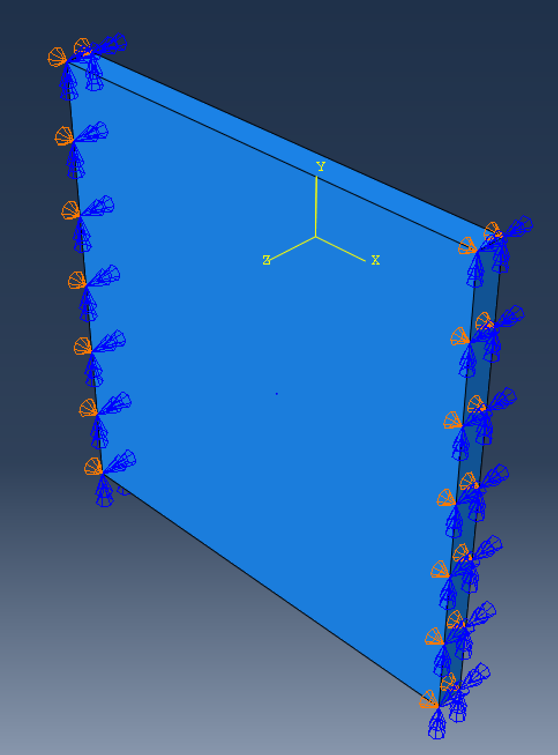
Scenario
Modelling a square plate with two opposite edges simply supported
Total edge length = 4
3 different thicknesses: 1/4, 1/8, 1/16
Assume properties:
ρ = .281, E = 28000, ν = .25
Examined using both shell and solid elements in the student version of Abaqus

Slide 3
Element Options
Solid Elements
Shell Elements
Used an 8-node linear brick with incompatible modes
Used an 8-node quadrilateral continuum shell, with reduced integration and default hourglass control

Slide 4
Solid Element Options
Reduced Integration
Incompatible Modes

Slide 5
Convergence Studies, 1/4 Plate

Slide 6
Natural Frequencies, 1/4 Plate
Solid Elements
Shell Elements
Mode | Natural Frequency
1 | 2.26
2 | 3.77
3 | 5.10
4 | 8.29
5 | 8.98
6 | 10.68
7 | 13.65
8 | 15.64
9 | 16.42
10 | 18.71
11 | 19.79
12 | 21.38
13 | 23.56
Mode | Natural Frequency
1 | 2.12
2 | 3.41
3 | 4.94
4 | 7.75
5 | 8.57
6 | 10.07
7 | 13.72
8 | 13.91
9 | 14.83
10 | 16.21
11 | 19.24
12 | 20.83
13 | 22.77
Modes 8, 9, 10 are pretty far apart

Slide 7
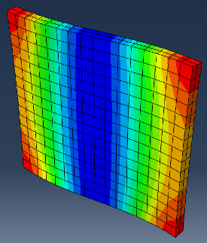
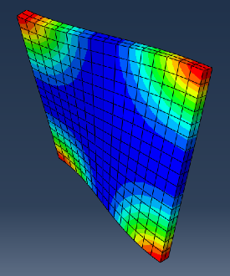
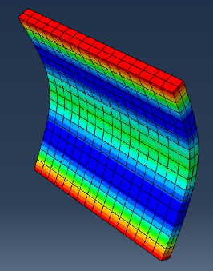
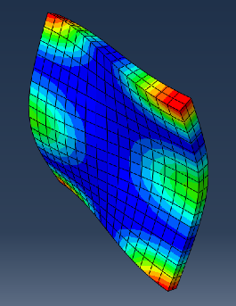
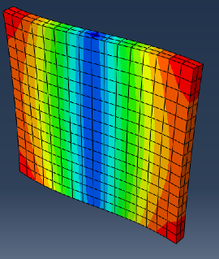
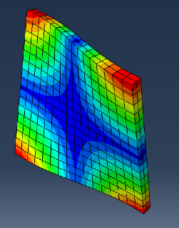
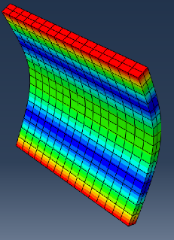
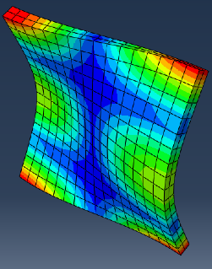
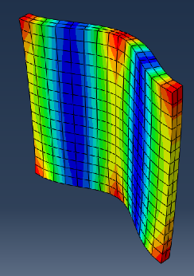
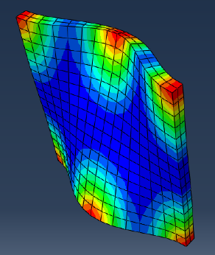
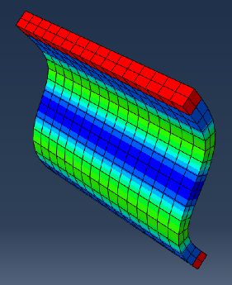
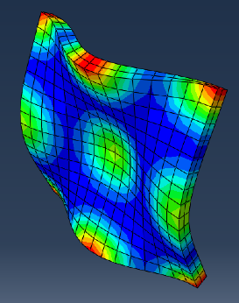
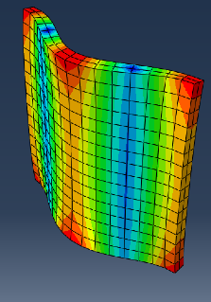
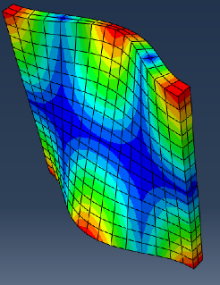
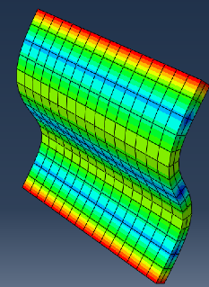
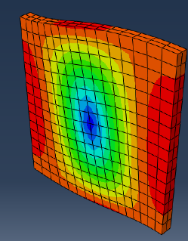
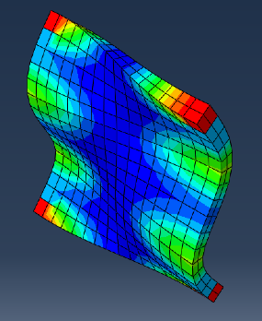
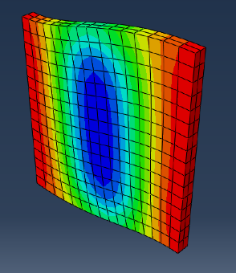
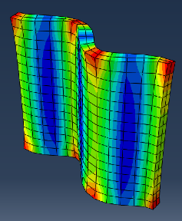
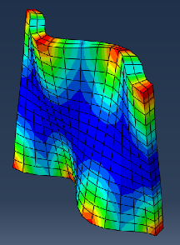
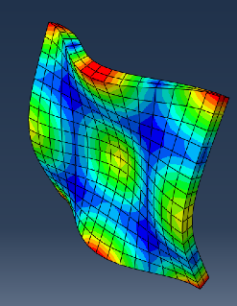
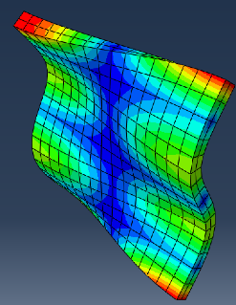
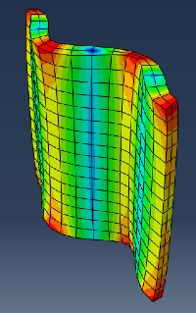
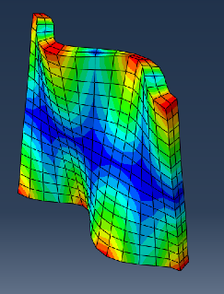
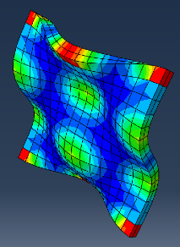
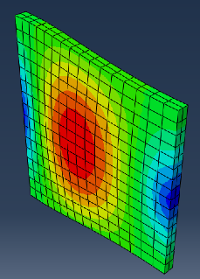
Mode Shapes, 1/4 Plate
Solid Elements
Shell Elements

Slide 8
Convergence Studies, 1/8 Plate

Slide 9
Natural Frequencies, 1/8 Plate
Solid Elements
Shell Elements
Mode | Natural Frequency
1 | 1.36
2 | 1.91
3 | 2.58
4 | 4.26
5 | 4.58
6 | 5.49
7 | 7.05
8 | 8.17
9 | 8.57
10 | 10.34
11 | 11.24
12 | 12.55
13 | 13.70
Mode | Natural Frequency
1 | 1.07
2 | 1.92
3 | 2.50
4 | 4.31
5 | 4.38
6 | 5.43
7 | 7.03
8 | 8.39
9 | 8.76
10 | 10.13
11 | 11.24
12 | 13.18
13 | 13.91

Slide 10
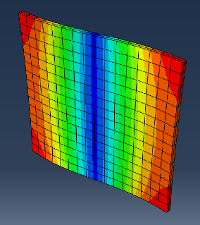
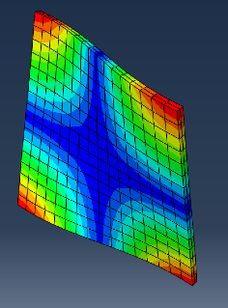
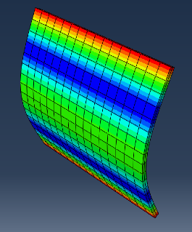
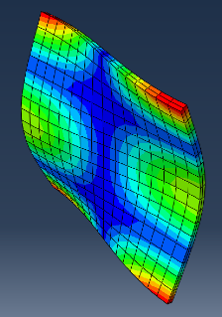
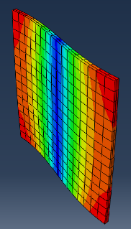
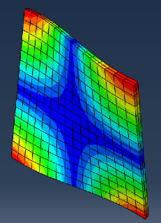
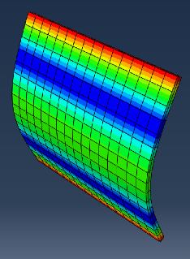
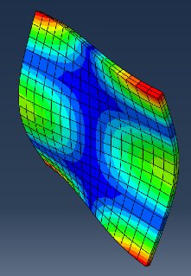
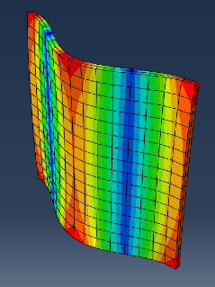
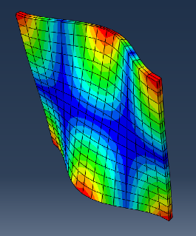
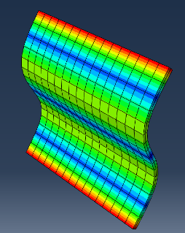
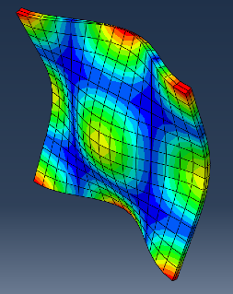
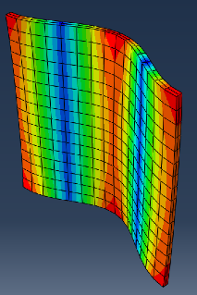
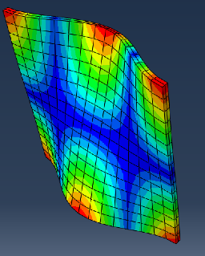
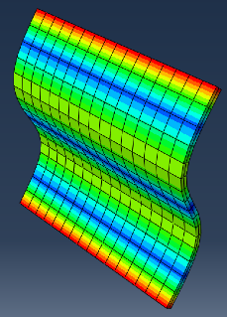
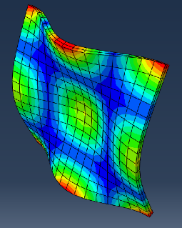
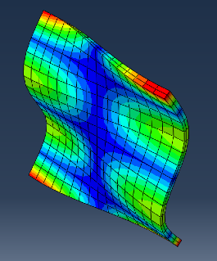
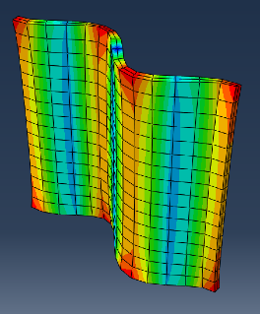
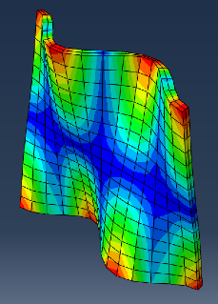
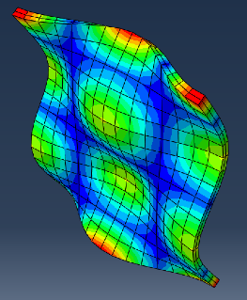
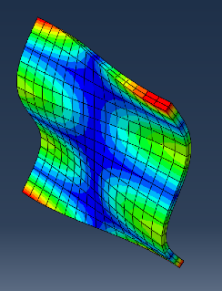
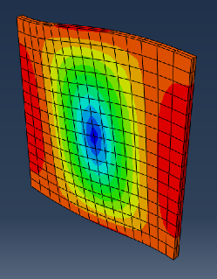




Mode Shapes, 1/8 Plate
Solid Elements
Shell Elements

Slide 11
Convergence Studies, 1/16 Plate

Slide 12
Natural Frequencies, 1/16 Plate
Solid Elements
Shell Elements
Mode | Natural Frequency
1 | 0.57
2 | 0.96
3 | 1.29
4 | 2.16
5 | 2.30
6 | 2.78
7 | 3.55
8 | 4.18
9 | 4.36
10 | 5.23
11 | 5.74
12 | 6.50
13 | 6.96
Mode | Natural Frequency
1 | 0.54
2 | 1.29
3 | 1.39
4 | 2.22
5 | 2.92
6 | 3.27
7 | 3.94
8 | 5.16
9 | 5.76
10 | 5.81
11 | 6.51
12 | 8.04
13 | 9.60

Slide 13


























Mode Shapes, 1/16 Plate
Solid Elements
Shell Elements

Slide 14
Conclusions
Solid Elements with incompatible modes converged faster than shell elements
Could use another round of h-refinement for shell elements
Solid Element and Shell Element mode shapes match for first few modes but then lose their parity

Slide 15
Questions Or comments

